Slide 1
Honda’s Training Road Map
Honda Supplier Support Training Resource

Slide 2
Honda’s Training Road Map Training Matrix ~ Core Curriculum
Training Matrix
~ Core Curriculum

Slide 3
Honda’s Training Road Map Training Matrix ~ Core Curriculum
Training Matrix Definition: A tool that can be used to track training and skill levels within an organization.
Core Curriculum Definition: set of common courses required for each specific department and/or specific departmental position.

Slide 4
Honda’s Training Road Map Training Matrix ~ Core Curriculum
Training Matrix & Core Curriculum Purpose: The purpose of the training matrix & core curriculum is to identify necessary skills & knowledge required for each position. It can also be used as a tool in Succession Planning to identify Associates who have critical skills needed for internal promotions.
Training Matrix & Core Curriculum Goal: The goal of the training matrix & core curriculum is to identify skills gaps and provide the necessary training to fill those gaps and allow Associates to become successful. Also, provides clear path to track each Associate’s acquired skill & knowledge progress.

Slide 5
Honda’s Training Road Map Training Matrix ~ Core Curriculum
Training Matrix Implementation Guidelines:
1. List the key roles in your organization.
2. List the competencies/skills required for each position; this step is completed with the management staff of each position. If you have many, you should cluster them. (i.e. – leadership skills, computer, technical, 5S categorical, etc.).
3. List the names for each individual for each position.
4. Determine how you want to code the matrix to indicate skill level, training needed, training completed, etc.

Slide 6
Honda’s Training Road Map Training Matrix ~ Core Curriculum
Training Matrix Implementation Guidelines (cont.):
5. Fill out matrix for each person, using your coding system to indicate current skills and any skill gaps. In order to complete the matrix, you will want to determine the Associate’s current skill level. This can be completed employing one or more of the following methods:
Supervisor/Manager assess each Associate’s skill level.
Associates complete self skill level assessment questionnaire.
Associate completes one or more skill level assessment test.

Slide 7
Honda’s Training Road Map Training Matrix ~ Core Curriculum
Training Matrix Implementation Guidelines (cont.):
6. Look for patterns, opportunities and areas of need.
7. Use your training matrix to assign Associates to different classes in order to meet those needs. Your starting point should be on skills that are considered most important based on what you learned from your Performance Analysis.

Slide 8
Honda’s Training Road Map Training Matrix ~ Core Curriculum
Training Matrix
Examples

Slide 9
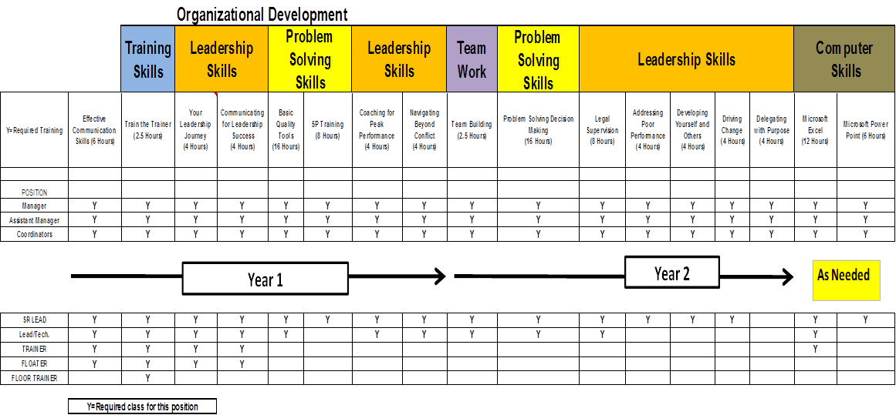
Honda’s Training Road Map Training Matrix ~ Core Curriculum
Training Matrix
~ Core Curriculum
Examples

Slide 10
Honda’s Training Road Map Training Matrix ~ Core Curriculum
Training Matrix
~ Core Curriculum
Examples

Slide 11
Honda’s Training Road Map Training Matrix ~ Core Curriculum
Core Curriculum Implementation Guidelines:
1. List the key roles in your organization.
2. Determine what competencies/skills required for each position; this step is completed with the management staff of each position. If you have many, you should cluster them. (i.e. – leadership skills, computer, technical, 5S categorical, etc.).
3. Identify training that will meet each need.
4. Re-assess competencies/skills periodically.

Slide 12
Honda’s Training Road Map Training Matrix ~ Core Curriculum
Core Curriculum
Examples

Slide 13
Honda’s Training Road Map Training Matrix ~ Core Curriculum
Core Curriculum
Examples

Slide 14
Honda’s Training Road Map Training Matrix ~ Core Curriculum
Core Curriculum
Examples

Slide 15
Honda’s Training Road Map Training Matrix ~ Core Curriculum
Core Curriculum
Examples

Slide 16
Honda’s Training Road Map Training Matrix ~ Core Curriculum
Core Curriculum
Examples

Slide 17
Honda’s Training Road Map Training Matrix ~ Core Curriculum
Core Curriculum
Examples

