Slide 1
Microsoft Teams App Instructions for non-Honda iPhone, Android or Tablet Users

Slide 2
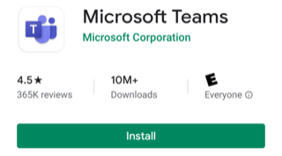
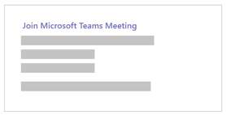
App Instructions for non-Honda iPhone, Android or Tablet Users
Prior to the meeting install Microsoft Teams app
this will take a few minutes
Step 1 – Go to App Store or Google Play Store
Step 2 – Search for Microsoft Teams
Step 3 – Install Microsoft Teams
Step 4 – Open Microsoft Teams
Step 5 – Return to email invitation; click on Join Microsoft Teams Meeting

Slide 3
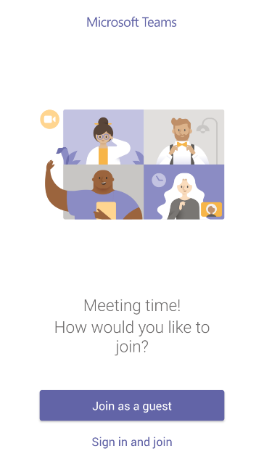
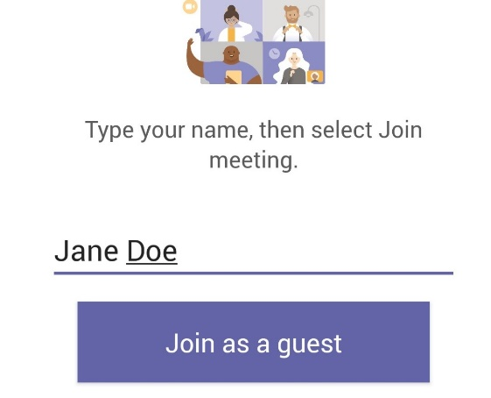
App Instructions for non-Honda iPhone, Android or Tablet Users
Step 6 – Choose Join as a guest
Step 7 – Type in your Full Name

Slide 4
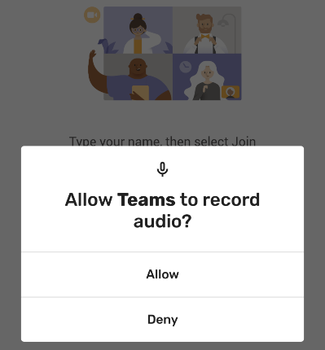
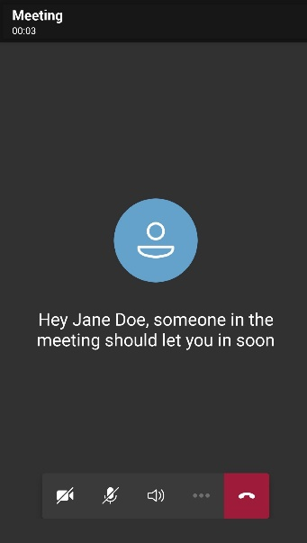
App Instructions for non-Honda iPhone, Android or Tablet Users
Step 8 – Choose Allow
Step 9 – Wait in the lobby until your receive access
Step 10 – Be sure your Mic is off

