Slide 1
Microsoft Teams Instructions Call In Instructions

Slide 2
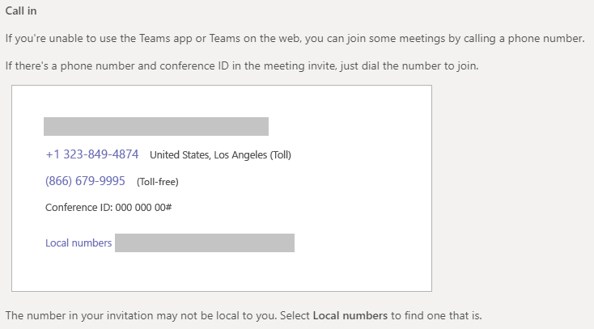
Call In Instructions

